Slide 1
Posttraumatic Stress Disorder: Diagnosis, Assessment, and Treatment
Shana Spangler, PsyD
Section Chief, Trauma Recovery Services
Greater Los Angeles VA Healthcare System
Notes:
Introductions

Slide 2
Outline of Presentation
DSM-5 Diagnostic Criteria
Assessment
  LEC, PCL-5, CAPS
Overview of treatments
Avoidance
Other considerations
Disclaimer: Today we will be discussing sensitive material, please feel free to step out at any time if you need a break.

Slide 3
Objectives
Learn to identify and talk about symptoms of PTSD and common reactions to trauma
Develop an increased ability to assess for PTSD using questionnaires and clinical interviews
Understand two of the empirically supported treatments for PTSD

Slide 4

What is PTSD? Diagnosis
  Diagnostic and Statistical Manual-5 (DSM-5)
  Trauma and Stress or Related Disorders
  Criterion A: Traumatic stressor
  Criterion B: Intrusion symptoms (Re-experiencing)
  Criterion C: Avoidance
  Criterion D: Negative alterations in cognition and mood
  Criterion E: Alterations in arousal and reactivity
  Criterion F: Time period
  Criterion G: Severity
  Criterion H: Not substance-related or GMC
(APA, 2013)
Notes:
History of PTSD.
B: 1, C: 1, D: 2; E: 2; F: >1 month
When I say PTSD what symptoms come to mind for you??

Slide 5
What is PTSD? Criterion A
The person was exposed to: death, threatened death, actual or threatened serious injury, or actual or threatened sexual violence as follows (one required):
  Direct exposure
  Witnessing, in person
  Indirectly, by learning that a close relative or close friend was exposed to trauma. If the event involved actual or threatened death, it must have been violent or accidental
  Repeated or extreme indirect exposure to aversive details of the events, usually in the course of professional duties
Notes:
Subjective experience in response to stressor – words used to describe a traumatic event
Recently changed: Used to be that you had to have exposure to a traumatic event and he person's response involved intense fear, helplessness, or horror (DSM-IV-TR). They took out how a person had to respond to get the criteria. Also expanded the number of things that qualify as traumatic event.
PTSD is unique among psychiatric diagnoses because of the great importance placed upon the etiological agent, the traumatic stressor. In fact, one cannot make a PTSD diagnosis unless the patient has actually met the "stressor criterion," which means that he or she has been exposed to an event that is considered traumatic.
Repeated or extreme indirect exposure to aversive details of the event(s), usually in the course of professional duties (e.g., first responders, collecting body parts; professionals repeatedly exposed to details of child abuse). This does not include indirect non-professional exposure through electronic media, television, movies, or pictures.

Slide 6
What is PTSD? Criterion A
Examples
  Combat
  Physical or sexual assault (e.g., military sexual trauma, MST)
    “Sexual trauma in the military does not occur only during training or peacetime and in fact, the stress of war may be associated with increases in rates of sexual harassment and assault”
    Can be childhood or adult-related
    Domestic violence
  Serious accident (e.g., auto accident)
  Natural disaster
  First responders, EMTs, Trauma therapists
(NCPTSD, 2016b)
Notes:
What do you think are some examples of trauma?

Slide 7
What is PTSD? Criterion B
Re-experiencing
  Recurrent, involuntary & intrusive memories
  Distressing dreams, nightmares
  Flashbacks: feeling that the event is actually happening again
  Psychological distress and/or physiological reactivity to cues
    Auditory (loud noises, helicopters, sirens, crying), visual (seeing people), smell (diesel fuel)
    https://www.youtube.com/watch?v=bgpRw92d1MA&feature=youtu.be
    Sweating, rapid heartbeat and breathing when thinking about the trauma (anniversary dates)
(NCPTSD, 2016b)
Notes:
Individuals with PTSD have had exposure to a traumatic stressor and then they have what are referred to as re-experiencing or intrusive thoughts. With re-experiencing sxs, the more you try not to think about the thoughts the more they come up
Pink elephant – Small taste of what I am talking about lets do a quick exercise. I want you to think about a pink elephant. Notice some detail about it. Now for the next 5 seconds I want you to not think about a pink elephant. How many of you thought about a pink elephant?
In my clinical experience, distressing, intrusive thoughts: may be fueled by content related to guilt (including survivor’s guilt), self-blame, shame
“that should have been me,” “why did I live?”
Body in fight-flight-freeze mode (increased heart rate and blood pressure, tunnel vision)

Slide 8
What is PTSD? Criterion C
Avoidance
  Avoid thoughts, feelings, conversations associated with the trauma (internal)
    Substance use/abuse, avoiding the news
  Avoid activities, places, people that arouse recollections (external)
    Avoiding going to sleep (e.g., if abused as a child in your bed), avoiding driving (e.g., after crash) , avoiding concerts because too open/crowded (e.g. makes you feel hypervigilant)
(NCPTSD, 2016b)
Notes:
Individuals with PTSD are constantly thinking about things they don’t want to be burdened with. How difficult that might be and how it leads to avoidance.
How might this show up in your work?
May lead to avoidance of going to treatment/hospital/VA/government agency
Feeling like I don’t belong. Very isolating.
How can I get close to anyone again?
No one will ever understand me.
I will always feel alone.

Slide 9
What is PTSD? Criterion D
Negative alterations in cognitions and mood
  Inability to recall key features of the traumatic event
    Not due to head injury, alcohol or drugs
  Persistent (and often distorted) negative beliefs and expectations about oneself or the world
    “I am bad.” “The world is completely dangerous.”
  Persistently negative trauma-related emotions
    Fear, horror, anger, guilt or shame
  Diminished interest in activities previously enjoyed
  Feeling alienated from others (e.g., detachment)
    Sadness, hopeless, “outside looking in”
  Persistent inability to experience positive emotions

Slide 10
What is PTSD? Criterion E
Alterations in arousal and reactivity
  Sleep difficulty
  Anger problems, irritability, aggressive behavior
    Conflict with others
  Self-destructive or reckless behavior
    Aggressive driving
  Concentration difficulty
    Staring out during class, frequent absences, difficulty meeting deadlines, poor performance, problems staying on task
  Always on-guard (hypervigilance)
    Feeling nervous, helpless, edgy, difficulty with crowds, constantly scanning/assessing for threat
  Exaggerated startle response
(NCPTSD, 2016b)
Notes:
Veterans: Trained to be on alert; never trained to be not on alert
How might this show up in your practice? What might you be on the look for?
Bridges
Loud noises associated with danger (beyond normal startle response)
Trash on the freeway
Imagine student soldier who worked on security detail or checkpoint trained to look for risk factors and when trained so vigorously, life and death, you can imagine how hard that is to shut off. They are walking on bruin plaza like that. Then say you hear an ambulance and you’re really on red alert. Now almost anything can be a sign of impending danger.
If a book falls to the ground in class may completely dysregulate a combat veteran with PTSD
Sitting in the back corner seat to be able to assess for danger

Slide 11
What is PTSD? Criterion F, G, & H
Duration of symptoms is more than 1 month
Significant distress and impairment
  Concerns arise when the disruptive reactions continue or get worse over time and interfere with family, work, school, or social life
  Commonly occurs with delayed expression. To get this specifier full diagnosis is not met until at least 6 months after the trauma(s), although onset of symptoms may occur immediately
Disturbance not due to substance or GMC

Slide 12
How common is PTSD?
60% of men, 50% of women will experience a traumatic stressor in their lifetime
8% of men, 20% of women develop PTSD after a trauma
Most people who are exposed to trauma will have some symptoms of PTSD following the event; Adjustment is normal!
PTSD has a waxing and waning course, which may increase with major life events (e.g., +/- stress, change of life role)
(NCPTSD, 2016a)
Notes:
Examples of stress –finals, transition to student life, birth of a child, graduation
Why higher in women? Perhaps women more willing to share symptoms. Women’s trauma may involve intimate violence.
“Women are more likely to experience sexual assault and child sexual abuse. Men are more likely to experience accidents, physical assault, combat, disaster, or to witness death or injury.”
Approximately 30% of people diagnosed with PTSD will have more persistent, chronic symptoms
Approximately 30% of veterans from Vietnam developed PTSD
Approximately 10% of the Veterans from Persian Gulf developed PTSD
As of the end of 2010, 2.04 million troops served in Operation Enduring Freedom, Operation Iraqi Freedom, and/or Operation New Dawn (OEF/OIF/OND), many with extensive exposure to combat or multiple deployments
16% are Women
6-20% of OEF/OIF/OND Veterans developed PTSD
Report of PTSD symptoms increased 6 months postdeployment
Higher rates among National Guard/Reserves

Slide 13
Assessment: Measures
Life Events Checklist
PTSD Checklist
  Use at intake to assist in assessing symptoms and weekly to track treatment progress
  PCL-S, M, C → PCL-5
  Range 0-80, 20 items, each item 0-4 score
  Provisional dx with symptom cluster (2 “moderately” or higher)
    Cluster B (items 1-5), cluster C (items 6-7), cluster D (items 8-14), and cluster E (items 15-20)
  Cutoff of 33 (until further psychometric work available)
  Look for B: 1, C: 1, D: 2; E: 2; F: >1 month
(Weathers et al., 2015)

Slide 14
Assessment: Measures
Clinician-Administered PTSD Scale for DSM-5 (CAPS-5)
  “Gold standard” in PTSD assessment, takes 45-60 minutes
  30-item structured interview administered by clinicians and clinical researchers
  20 items target onset and duration of symptoms, others target distress, impact, validity, severity
Good to give depression screener as well (e.g., BDI, PHQ-9)
Training: https://www.ptsd.va.gov/professional/continuing_ed/caps5_clinician_training.asp
Notes:
Measurement based care

Slide 15
Assessment: Measures
Sample CAPS Item: Onset, duration & frequency
In the past month, have you had any unwanted memories of (EVENT) while you were awake, so not counting dreams? How does it happen that you start remembering (EVENT)?
[If not clear:] (Are these unwanted memories, or are you thinking about [EVENT] on purpose?) How much do these memories bother you? Are you able to put them out of your mind and thing about something else? How often have you had these memories in the past month? # of times ______.

Slide 16
Assessment: Measures
Sample CAPS item: Severity Rating:
  0. Absent: The respondent denied the problem
  1. Mild / subthreshold: The respondent described a problem that is consistent with the symptom criterion but isn't severe enough to be considered clinically significant.
  2. Moderate / threshold: The respondent described a clinically significant problem. The problem would be a target for intervention. This rating requires a minimum frequency of 2 x month or some of the time (20-30%) PLUS a minimum intensity of Clearly Present.
  3. Severe / markedly elevated: The respondent described a problem that is above threshold. The problem is difficult to manage and at times overwhelming, and would be a prominent target for intervention. This rating requires a minimum frequency of 2 x week or much of the time (50-60%) PLUS a minimum intensity of Pronounced.
  4. Extreme / incapacitating: The respondent described a dramatic symptom, far above threshold. He problem is pervasive, unmanageable, and overwhelming, and would be a high-priority target for intervention.

Slide 17
Assessment: Clinical Interview
Assess for co-occurring conditions, including depression, suicidality, substances
Draw out conceptualization of PTSD using symptoms that they provide
Be attuned to role of avoidance
http://www.ptsd.va.gov/professional/assessment/overview/index.asp
Avoidance
Re-Experiencing
Arousal
Negative Cognitions & Mood
Notes:
Avoidance: underreporting

Slide 18
Treatments: Review
List of empirically supported treatments includes:
  Cognitive Processing Therapy (CPT)
  Prolonged Exposure (PE)
  Eye Movement Desensitization Reprocessing (EMDR)

Slide 19
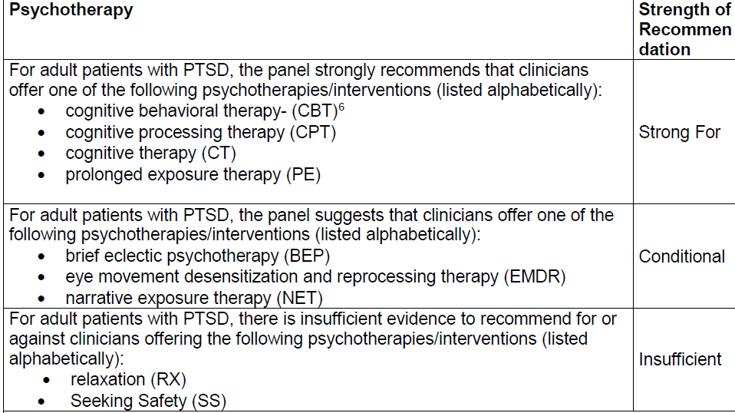
Treatments: APA Clinical Practice Guideline for the Treatment of PTSD in Adults (released 2/24/17)
Table 1. Summary of Recommendations of the APA Guideline Development Panel for the Treatment of PTSD (released in 2017)

Slide 20
Treatments: VA/DOD Clinical Practice Guideline for the Management of Posttraumatic Stress Disorder and Acute Stress Disorder
Released in 2017
Strong recommendation: “[I]ndividual, manualized trauma-focused psychotherapy (see Recommendation 11) over other pharmacologic and non-pharmacologic interventions for the primary treatment of PTSD.”
Strong recommendation: “For patients with PTSD, we recommend individual, manualized trauma-focused psychotherapies that have a primary component of exposure and/or cognitive restructuring to include Prolonged Exposure (PE), Cognitive Processing Therapy (CPT), Eye Movement Desensitization and Reprocessing (EMDR), specific cognitive behavioral therapies for PTSD, Brief Eclectic Psychotherapy (BEP), Narrative Exposure Therapy (NET), and written narrative exposure.”

Slide 21
Treatments: Cognitive Processing Therapy (CPT)
Predominantly social-cognitive theory
  Reconcile information about the trauma with prior schemas
Theory that recovery from trauma is a natural process and some people get “stuck” due to:
  Unprocessed natural emotions
  Ways of thinking, especially that beliefs become extreme after trauma (*focus) – assimilation vs. accommodation
Treatment addresses stuck points through:
  Assessment of stuck points: “Impact statement”
  Identification of stuck points: written trauma statement (optional)
  Reviewing common stuck point areas of: Safety, Trust, Power/control, Esteem, Intimacy
  Using CBT approaches to challenge extreme thinking

Slide 22
Treatments: Cognitive Processing Therapy (CPT)
General overview
Session 1: Introduction and Education | Session 7: Patterns of Problematic Thinking
Session 2: The Meaning of the Event | Session 8: Safety Issues
Session 3: Identification of Thoughts and Feelings | Session 9: Trust Issues
Session 4: Remembering the Traumatic Event | Session 10: Power/Control Issues
Session 5: Identification of Stuck Points | Session 11: Esteem Issues
Session 6: Challenging Questions | Session 12: Intimacy Issues and Meaning of the Event

Slide 23
Treatments: Cognitive Processing Therapy (CPT)
Resick, P.A., Monson, C.M., & Chard, K.M. (2017). Cognitive Processing Therapy for PTSD: A comprehensive manual. New York: Guilford.
Used to have trauma account; now it is up to the patient to decide if they want to do the trauma account.
Notes:
With “normal” people, reciprocal relationship b/w prefrontal cortex and amygdala to stop fight-flight and return to parasympathetic.
With PTSD, amygdala has increased responsiveness and prefrontal cortex has decreased activity. Therefore, slow to recognize that threat of danger has ended.
Research shows that the act of labeling things can activate the prefrontal cortex. Thus, talking about and answering questions may lead to greater affective regulation: cognitive therapy.
If someone terminates therapy because of trauma account, can actually reach more people by not having trauma account (more people stay in tx).

Slide 24


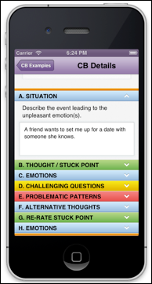
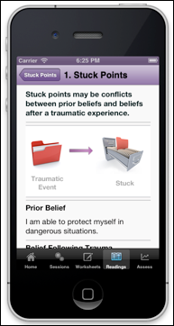
Treatments: CPT Coach

Slide 25
Treatments: Prolonged Exposure (PE)
Theory: two factors maintain PTSD
  Avoidance of internal and external reminders (primary)
  Inaccurate & unhelpful trauma-related beliefs & thoughts
Avoidance prevents emotional processing of the trauma & modification of trauma-related beliefs
Mechanisms of PE
  Promote emotional engagement with trauma memories (opposite of numbing)
  Habituation of anxiety
  Modify erroneous cognitions
  Discriminate between the event and now
Notes:
Repeated activation of the trauma memory, need to disconfirm through treatment. Example: if trash indicated danger/bomb, then being a trash collector would be difficult. With time, it disconfirms the belief that trash is dangerous.
Fear is the body’s way of helping the body to escape danger. This can be normal (run away from the bear) to facilitate survival. But it can cause problems if we begin to inaccurately associate things with fear. Goal: activate the fear structure and begin to incorporate accurate/realistic assessments. It also helps disconfirm “I’ll lose control” (thoughts). Alter fear structure, habituate to stimuli.
With PTSD, person begins to associate many things as dangerous and have negative interpretations of self (The world is dangerous, I am incompetent to cope).

Slide 26
Treatments: Prolonged Exposure (PE)
Treatment
  Education (common reactions to trauma, rationale for treatment)
  Breathing retraining
  In vivo exposures (external)
  Imaginal exposures (internal)
    As treatment goes on, focus is on “hot spots” where the narrative is not fully processed
    Processing and organization of the trauma (digesting) is focus of treatment
Notes:
Can re-visit the memory 3-10 times per session

Slide 27
Treatments: PE Handouts
In vivo exposure homework recording form
  Situation that you practiced____________
Imaginal exposure homework recording form
Date & Time | SUDS |  |  | Date & Time | SUDS
 | Pre | Post | Peak |  | Pre | Post | Peak
1. |  |  |  | 5.
2. |  |  |  | 6.
3. |  |  |  | 7.
4. |  |  |  | 8.
DATE & TIME
SUDS Pre
SUDS Post
Peak SUDS

Slide 28
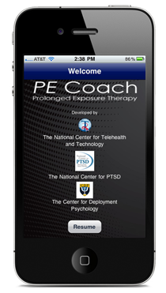
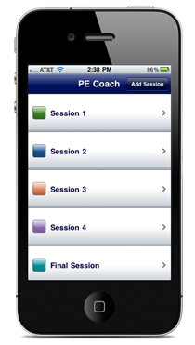
Treatments: PE Coach

Slide 29
Treatments: Other
EMDR
  Information processing therapy: focus on the traumatic event/s, current triggers.
  Uses “dual stimulation” with bilateral eye movements, tones, or taps while engaging in imaginal exposure
CBT for PTSD
DBT-PE for Complex Trauma
  Incorporates phase-based treatment, Stage 1= Stabilization, Stage 2= PE
CBT-I and PE

Slide 30
Avoidance
Efforts to avoid feelings (numbing), thoughts (don’t think about it), behaviors (avoid people, places)
Maintains symptoms of PTSD
Patient avoidance:
  Not selecting or disclosing the index trauma
  Humor
  Focus on other issues/distraction
  Not completing homework
  Not coming in
  Holding back emotion (anger, sadness)

Slide 31
Avoidance
Therapist avoidance
  “The patient is too fragile right now.”
  Not checking on homework
  Focusing on stressful daily events instead of homework
  Not asking for details
Notes:
Ex: patient’s husband diagnosed with cancer

Slide 32
Avoidance
Addressing avoidance
  Discuss it early (normalize)
    You may notice anxiety about coming in...
  Problem-solve
    What could get in the way of coming in?
  There’s No Such Thing as a Dragon
  Motivational enhancement
  Keep doing the homework (don’t collude with the avoidance)
  Consult!

Slide 33
Treatments: Video clip
The War Within: Treating PTSD
CBS 60 minutes
Notes:
Any thoughts? 12:48
Will not “relive” but “revisit” the trauma
Difficult treatment because we want to help people, and they will be anxious and struggle in session.

Slide 34
Additional Considerations: Primary Care
Primary Care:
  Provide education about symptoms and presentation
    Ex. Sexual trauma can have a significant impact on feeling safe in the room, especially with providers who are the same gender as the perpetrator; increased avoidance/distress related to invasive exams
    Ex. Nightmares can indicate distress (e.g., increase related to a divorce with rumination about negative life event) rather than reflect a response to a traumatic event
  Discuss how PTSD can impact health
  Explore the use of a screener (PC-PTSD5)
    Positive screen does not indicate PTSD, but reflects that symptoms are present that may require further evaluation.
    Available online: https://www.ptsd.va.gov/professional/assessment/documents/pc-ptsd5-screen.pdf
(Prins et al., 2015)
Notes:
In the past month, have you...
Had nightmares about the event(s) or thought about the event(s) when you did not want to?
Tried hard not to think about the event(s) or went out of your way to avoid situations that reminded you of the event(s)?
Been constantly on guard, watchful, or easily startled?
Felt numb or detached from people, activities, or your surroundings?
Felt guilty or unable to stop blaming yourself or others for the event(s) or any problems the event(s) may have caused?

Slide 35
Additional Considerations: Psychosocial Stressors
Other stressors:
  Homelessness
  Legal issues
  School, work, family stressors
  Medical illness
Active substance use
Insomnia

Slide 36
References
American Psychiatric Association. (2013). Diagnostic and statistical manual of mental disorders (5th ed.). Washington, DC: Author.
American Psychological Association. (2017). Clinical practice guideline for the treatment of Posttraumatic Stress Disorder (PTSD) in Adults. Retrieved from the APA website on October 10, 2018, https://www.apa.org/ptsd-guideline/ptsd.pdf
Department of Veterans Affairs and Department of Defense. (2010). VA/DoD clinical practice guideline for the management of post-traumatic stress: Guideline summary.
National Center for PTSD. (2016a). How common is PTSD. Retrieved from the National Center for PTSD Website on August 17, 2016, http://www.ptsd.va.gov/public/PTSD-overview/basics/how-common-is-ptsd.asp.
National Center for PTSD. (2016b). What is PTSD?. Retrieved from the National Center for
PTSD Website on August 17, 2016, http://www.ptsd.va.gov/public/PTSD-
overview/basics/what-is-ptsd.asp.

Slide 37
References
Prins, A., Bovin, M. J., Kimerling, R., Kaloupek, D. G, Marx, B. P., Pless Kaiser, A., & Schnurr,
P. (2015). Primary Care PTSD Screen for DSM-5 (PC-PTSD-5) [Measurement instrument]. Retrieved from the National Center for PTSD Website on September 10, 2018, https://www.ptsd.va.gov/professional/assessment/screens/pc-ptsd.asp
VA/DOD (2017). VA/DOD Clinical practice guideline for the management of posttraumatic
stress disorder and acute stress disorder. Retrieved on October 10, 2018 from https://www.healthquality.va.gov/guidelines/MH/ptsd/VADoDPTSDCPGFinal0124 18.pdf
Weathers, F.W., Litz, B.T., Keane, T.M., Palmieri, P.A., Marx, B.P., & Schnurr, P.P. (2013). The
PTSD Checklist for DSM-5 (PCL-5). Scale available from the National Center for PTSD at www.ptsd.va.gov.

